Slide 1

Bootstrap Pass Down

Slide 2
Include files

Slide 3
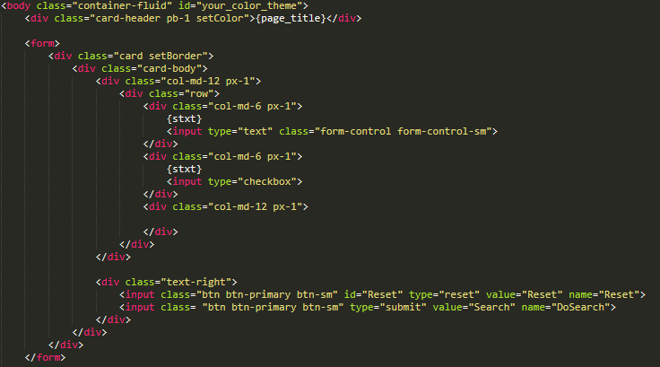
Basic Structure for listing search

Slide 4
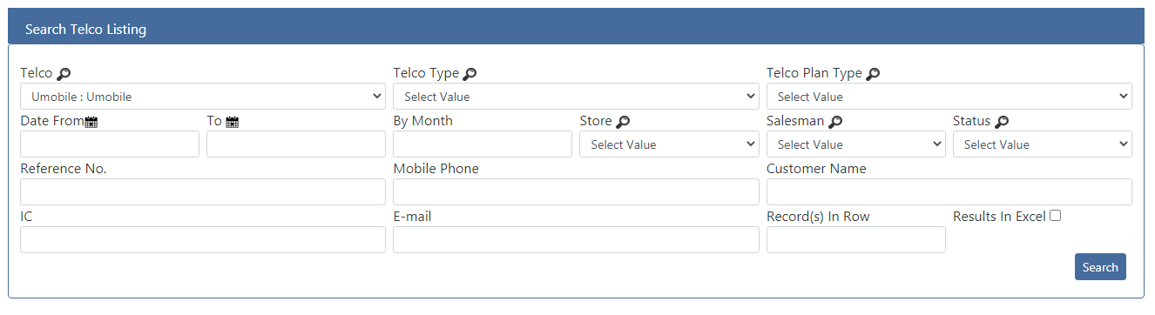
card-header pb-1 setColor
card setBorder

Slide 5
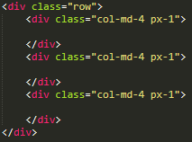
Each row of 12 columns is divided into 4 columns each

Slide 6
Text-right
btn btn-primary btn-sm

Slide 7
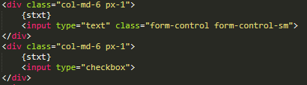
Inputs
Form-control no need to apply for checkbox
Form-control is for Bootstrap’s responsive input

Slide 8
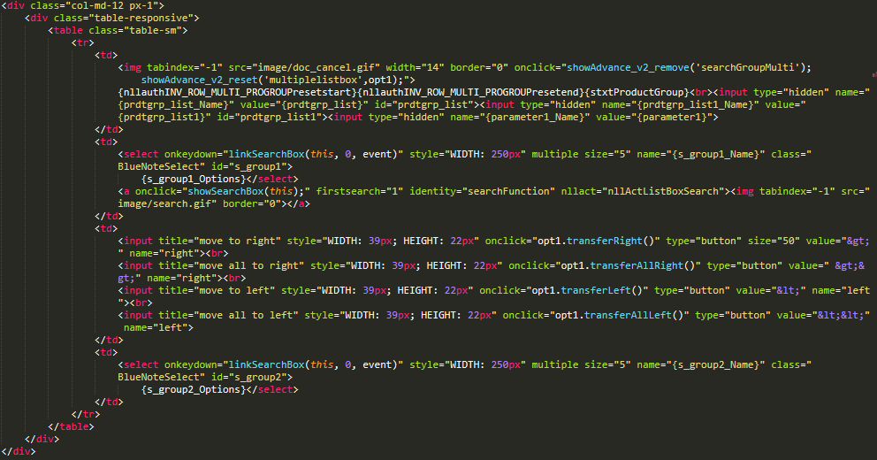
Multi Select Box
Multi select box need as much space as possible so it’s best to use col-md-12
Just add a <div> with class .table-responsive
Use .table-sm to shrink the table

Slide 9
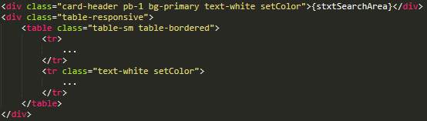
Basic structure of listing table
Use the same code for the table header
Add .div to enable responsive table
Use table-sm for smaller table, .table-bordered to enable border

Slide 10
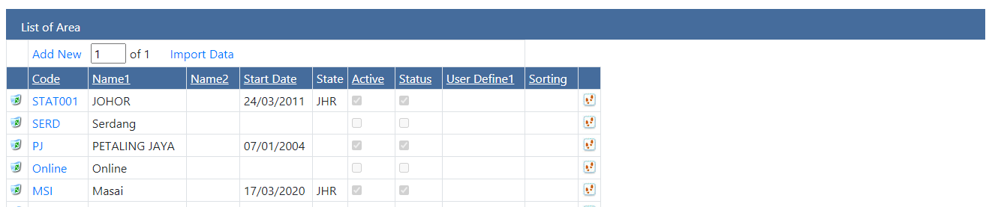
card-header pb-1 bg-primary text-white setColor
text-white setColor

Slide 11
Sizing
Property
m – margin
p – padding
Sizing
t – top
b – bottom
l – left
r – right
x – left & right
y – top & bottom

Slide 12
Styles from Bootstrap
Text color
text-white (for white text)
Font-weight-bold (for bold text)
Background color
bg-dark (for dark background)
Font-weight-bold (for bold text)
Sizes
lg (for large)
md (for medium)
sm (for small)

Slide 13
SASS (.SCSS)
Located inside Themes/Custom/themes.scss
There is two files colors.scss and themes.scss.
Colors.scss contains all defined color variables.
themes.scss contains .setColor and .setBorder styles
Must use Live SASS Compiler inside VS code to compile the scss into css.

Slide 14
Search (nll_common_search.js)
For search function to work normally, use isBootstrap=true; place it inside <script></script>

Slide 15
New Tab Styles
The new tab style (based on tabsstyle2.css) is located in Themes/BlueNote/tabsstyle3.css

